Slide 1
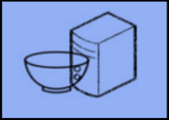
CIS 3365 Group Project
META SOLUTIONS GROUP
Hibbard, Schelling M
Mason, Kameron A
Momin, Shafin S
Nguyen, Andy P
Nguyen, Peter Q
Patel, Krishnali
Rahman, Ahmed N
Syed, Taqi
Ghafour, Mohamad

Slide 2
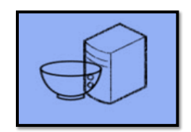
Project Requirements
During the first phase of this project we decided of a list of 100 requirements for this project.
This mainly included getting what the customer needed into this Database system.
We added features to improve the efficiency of their day to day business.
Features Including
Each specified job/project needs an ID: ie, project ID customer ID payment ID ect...
Specific types of data storage such as categories for each type of sign (wall, ground, window, door, banner)
Totaling Final expected payment of a job
Ability to have reports

Slide 3
Evolution of the ERD

Slide 4
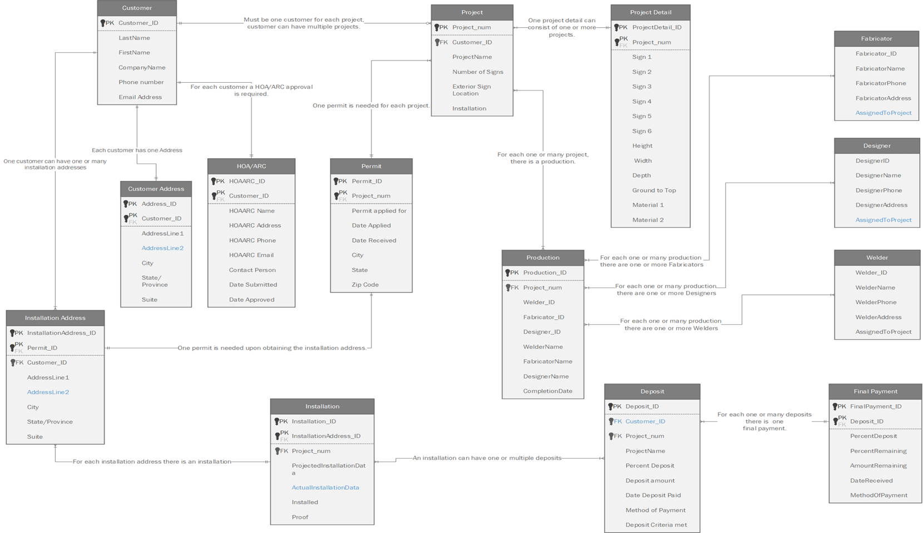
Notes:
First (pase1)

Slide 5
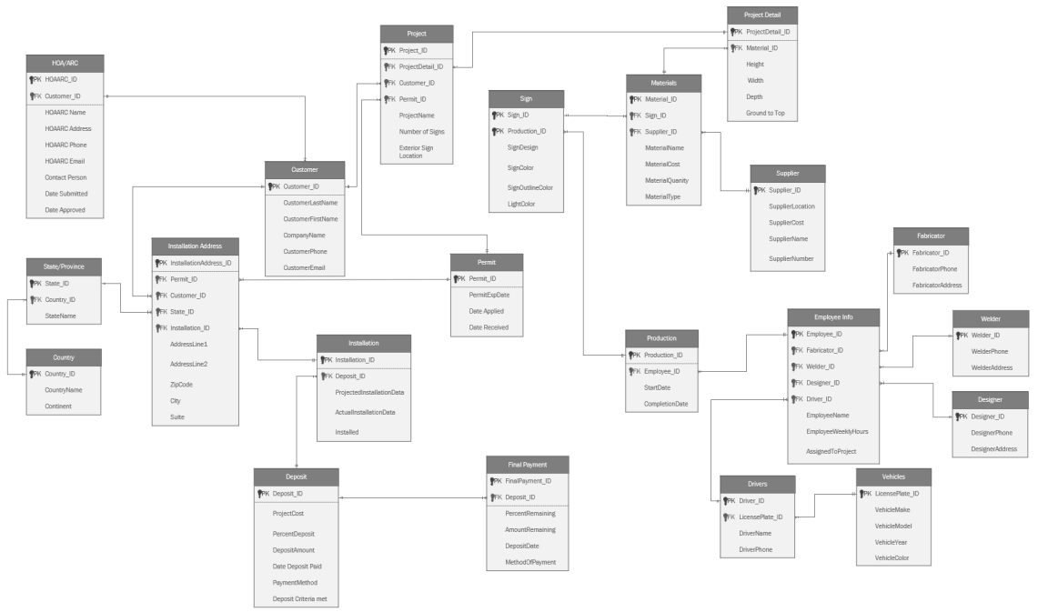

Slide 6
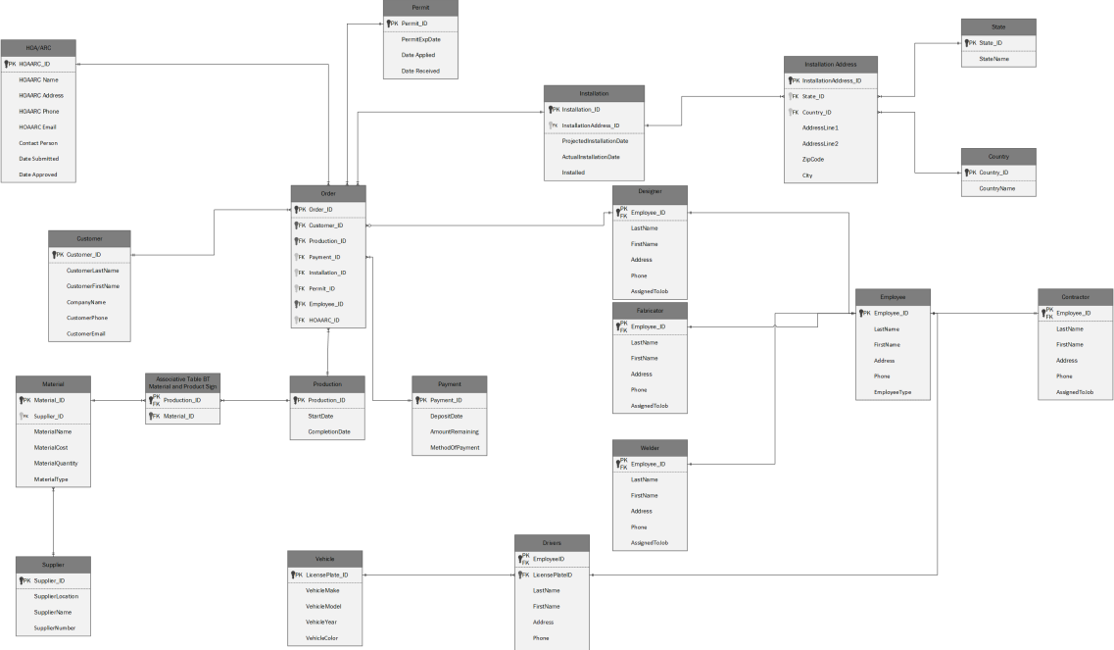
final?
Notes:
FINAL

Slide 7
Evolution of the Prototype

Slide 8
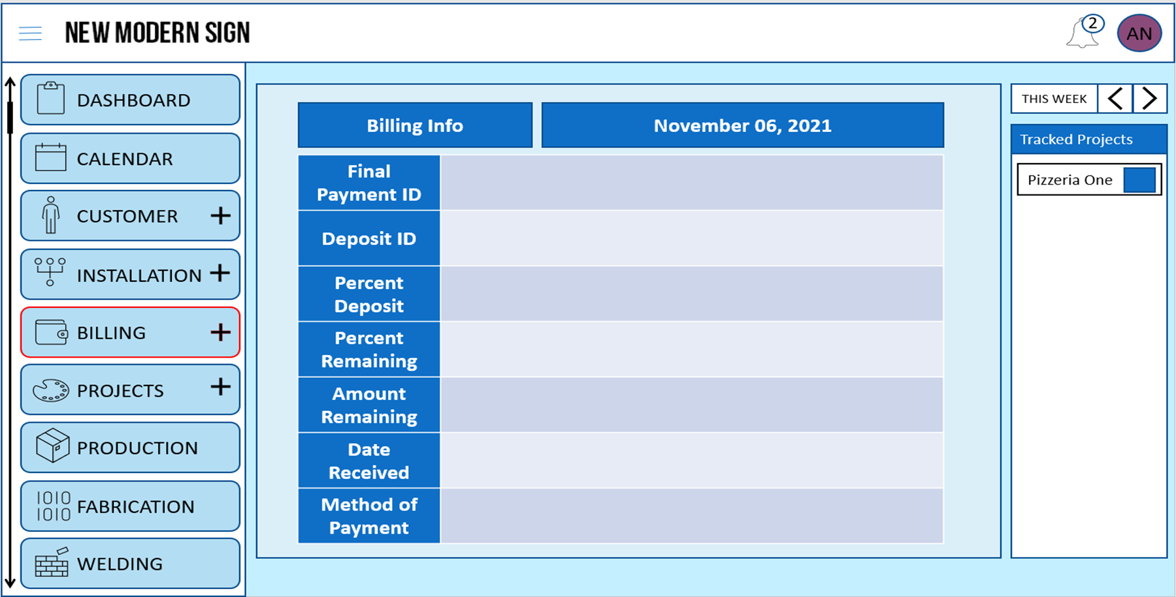

Slide 9
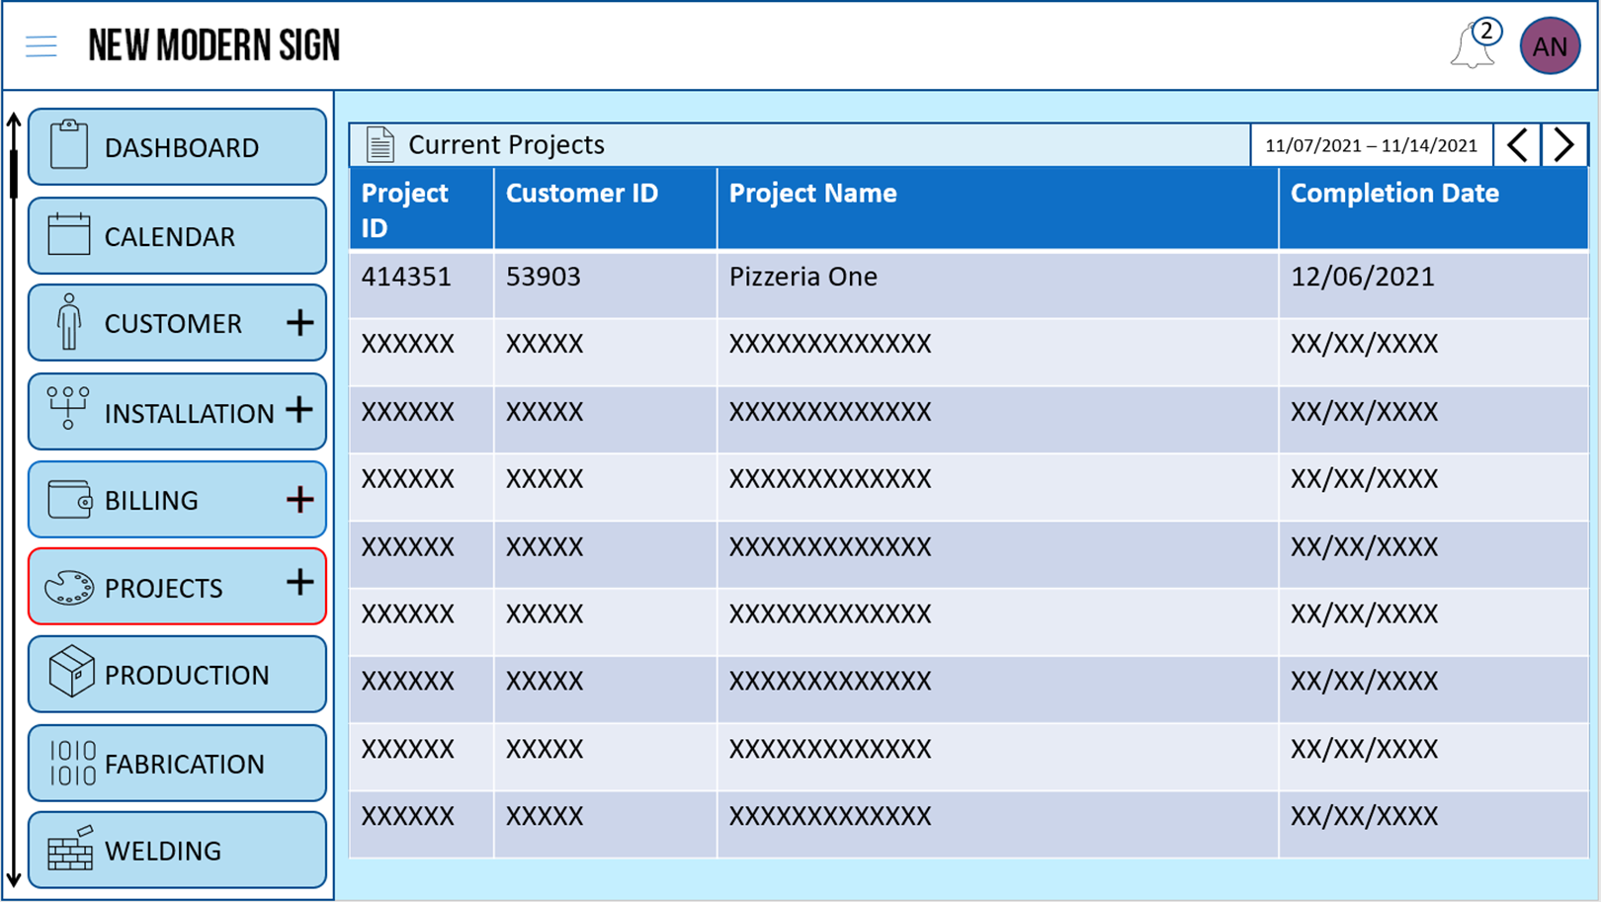

Slide 10
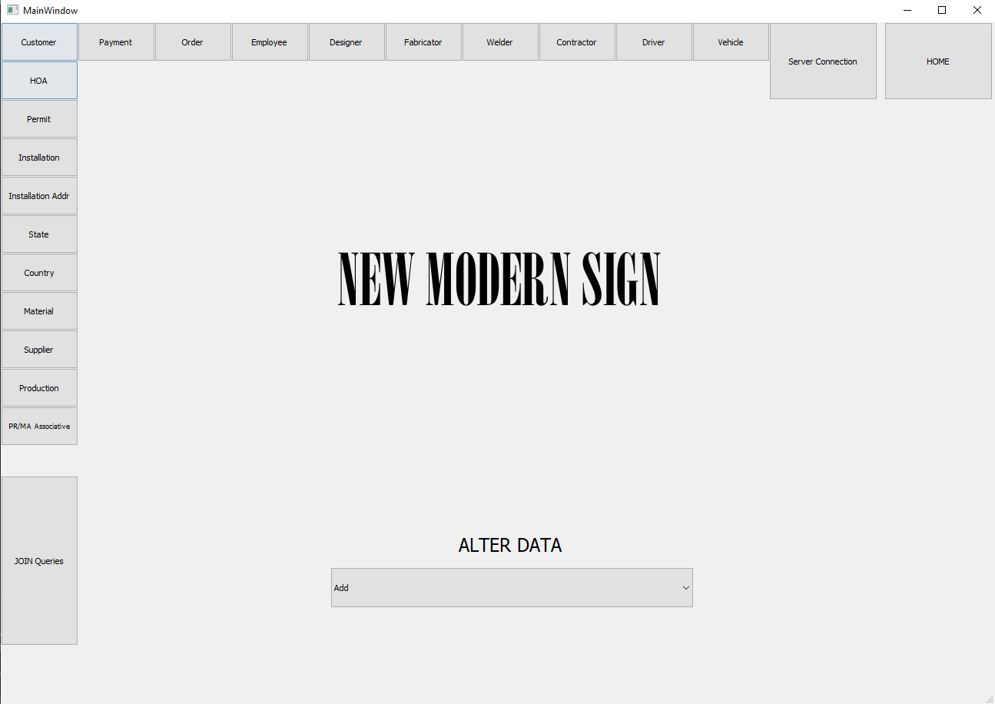

Slide 11
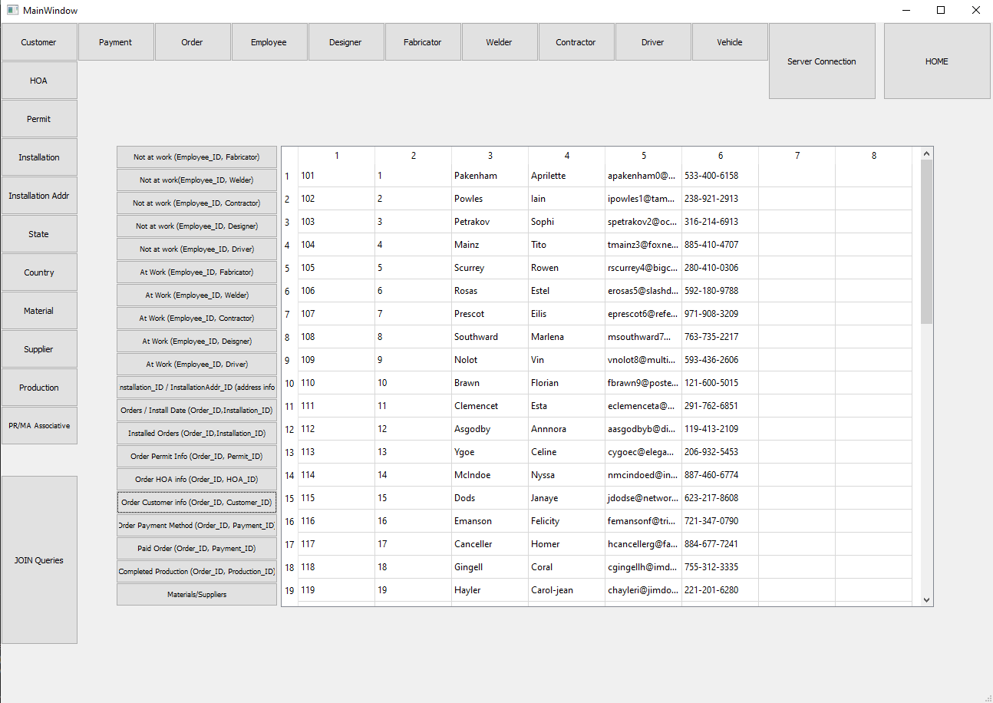
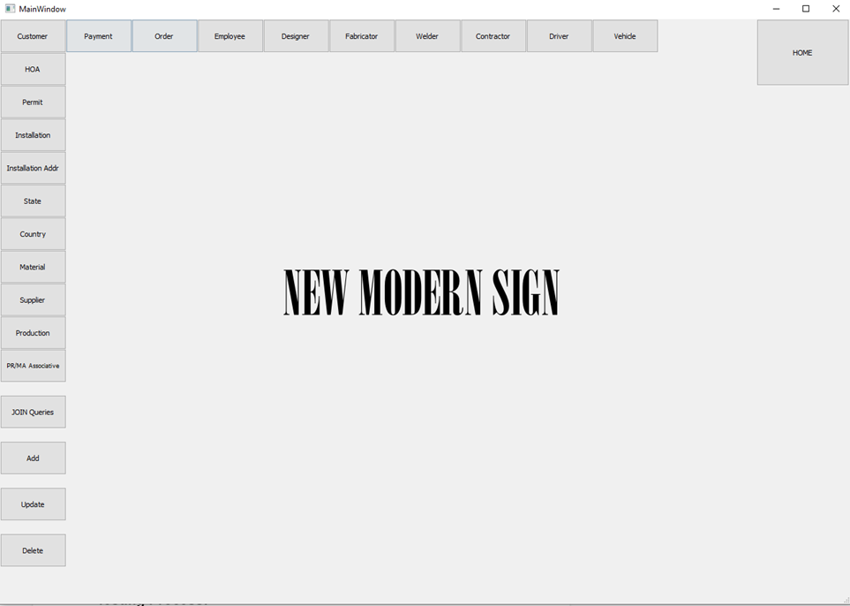

Slide 12
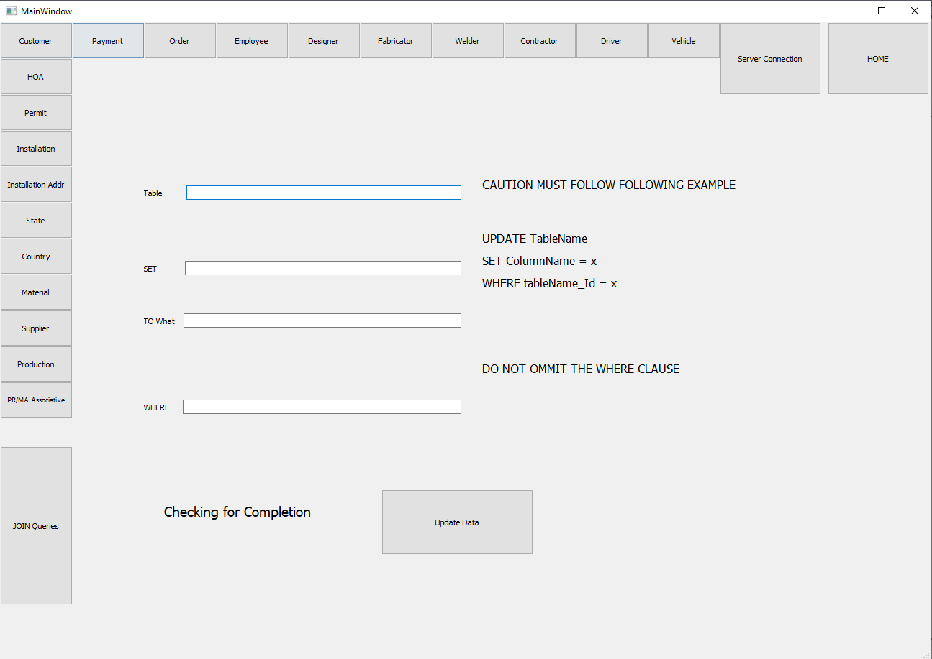

Slide 13
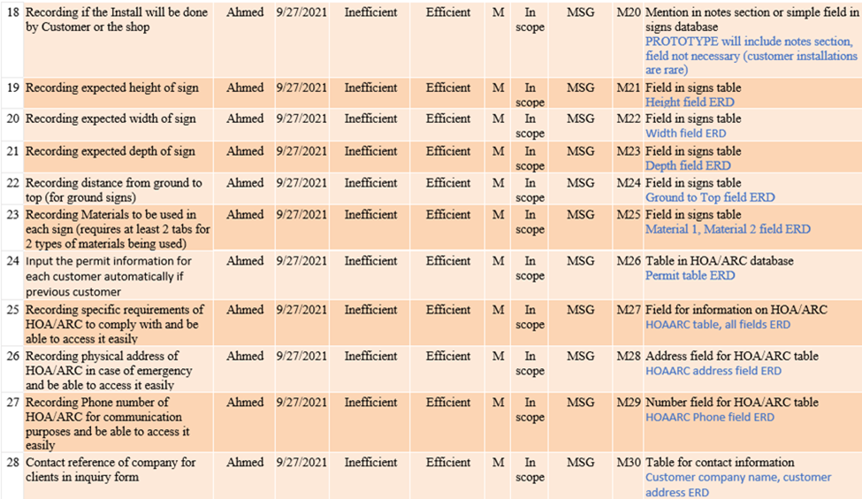
Initial Requirements List

Slide 14
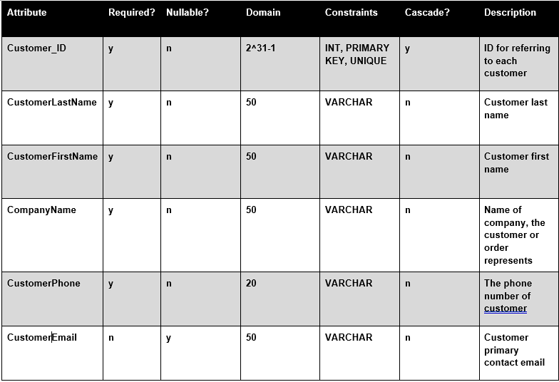

Slide 15

Questions?

Slide 16
And Now Presenting our Database System Solution:

